Slide 1
Brain Computer Interface Using ML
UJJWAL RAJ NEPAL

Slide 2
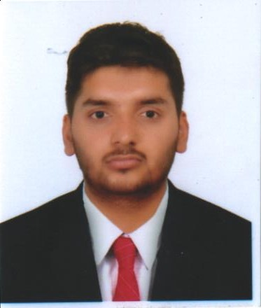
ABOUT ME
4.0 Engineer Otonomis Pvt. Ltd
Working on future of Moving Vehicles in Nepal
“Interested Artificial General Intelligence & Future of AI”

Slide 3
Contents
Brain Waves
Types
BCI Intro
Types
Application
BCI Components
ML trends in BCI
General Algorithms
Brain Controlled WheelChair

Slide 4
BRAIN WAVES

Slide 5
80 billion neurons communicate in specific rhythms and groups oscillating in very specific frequencies
Brain waves are measured in cycles per second i.e Hz
Lower the frequency lower is the brain activity
Handy analogy with musical notes, lower the frequency waves are deeply penetrating, higher frequency are more subtle

Slide 6
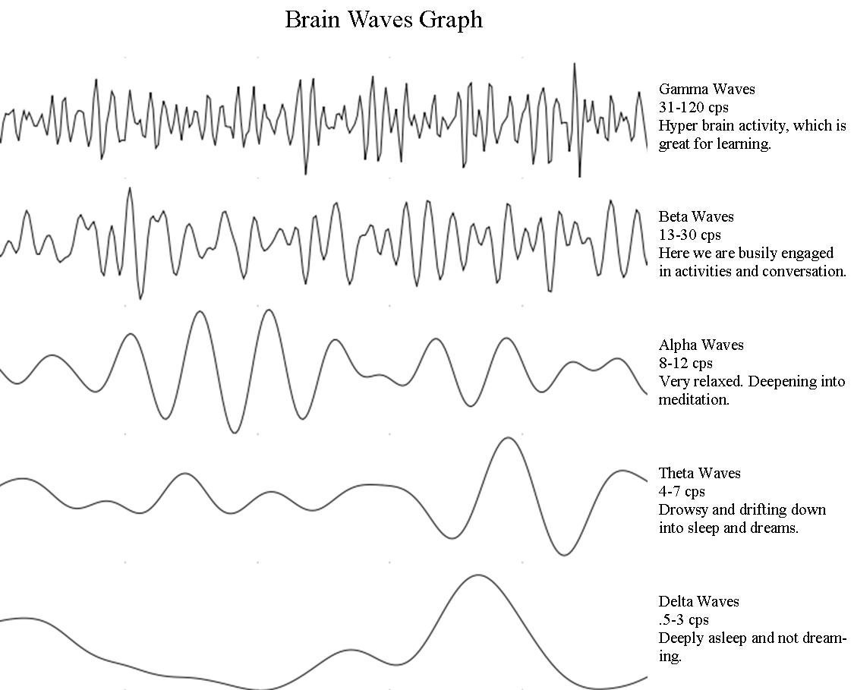
Types

Slide 7
BCI Introduction

Slide 8
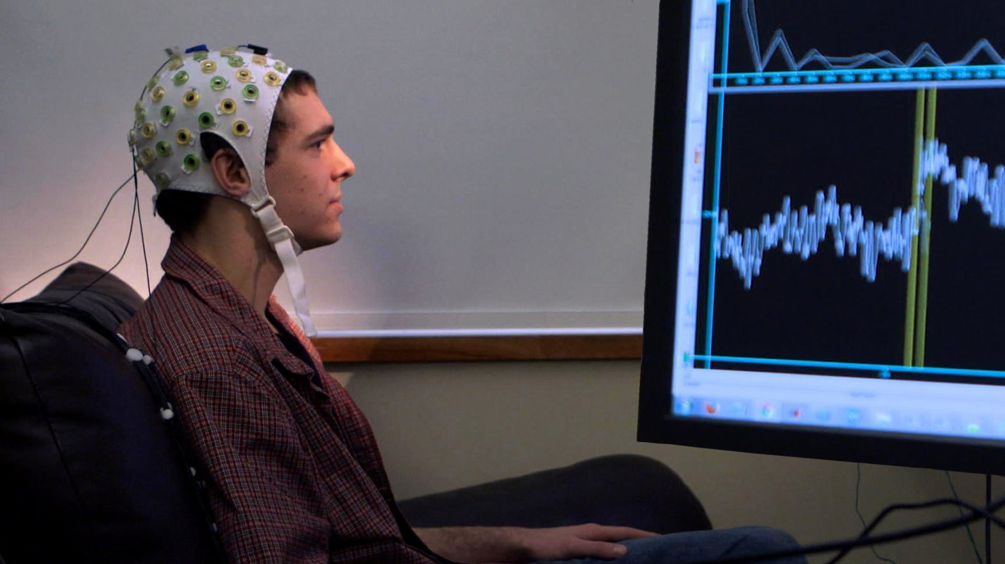
Brain Computer Interface are systems that allow communication between the brain and various machines.

Slide 9
BCI Types
Invasive , mini electrodes are directly implanted into the brain during neurosurgery
Semi Invasive, electrodes placed on the exposed surface of the brain eg, Electrocorticography ECoG
Non Invasive, electrodes are kept touching the head externally

Slide 10
Applications of BCI
Medical Applications
Neuroergonomics and smart environment
Neuromarketing and advertisement
Education and self regulation
Games and Entertainment
Security and Authentication

Slide 11
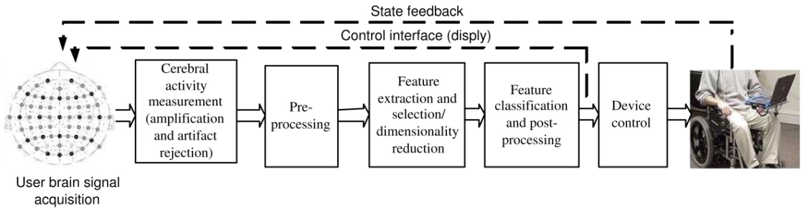
Components of BCI

Slide 12
ML Trends In BCI

Slide 13
Major challenge of BCI is classification of the brain signals in Real Time to make RTS
Intriguing fact is now Deep Learning is being used to acheive state of the arts systems
P300 reposne is being used with conv net technique which works on response based on stimuli
Classification is the main area where ML algorithms are being used in non invasive BCI

Slide 14
General Classification Algorithms for BCI
K means Clustering for unsuprevised learning
Linear classifiers
Finite State Machine based systems are common in decision making
ANN

Slide 15
BRAIN Controlled WheelChair
Ujjwal Raj Nepal , Rajan Gyawali

Slide 16
Components Used
Neurosky Mindwave
Raspberry Pi
Optocoupler
Motor Driver high current MOSFET chip
Wiper Motor

Slide 17
Methodology
Signal from Brain
Neurosky Mindwave
Raspberry Pi
Signal Processing(FFT, Filtering)
Power Calculation
Feature Extraction
Classification
FSM
WheelChair Control

Slide 18

Thank you!
Any Queries???

